Slide 1


PREDICTING LOAN DEFAULTERS FOR BAJAJ FINSERV LTD CAPSTONE PROJECT
Presentation by Tendai Jonhasi
July 30th 2024
unsplash.com

Slide 2

Executive Summary
In the financial industry, accurately assessing the creditworthiness of borrowers is paramount for lenders to mitigate risks and maintain a healthy lending portfolio. Identifying potential defaulters—individuals at a higher risk of failing to repay their loans—helps lenders make informed decisions, minimize financial losses, and ensure financial stability. This project aims to develop a predictive model that can classify borrowers as defaulters or non-defaulters based on various financial and demographic factors. Utilizing a dataset provided by Bajaj Finserv, we embarked on a comprehensive data analysis and model-building process to achieve this objective. The dataset includes information on loan types, loan amounts, interest rates, loan terms, employment types, income levels, credit scores, gender, marital status, and education levels of borrowers.
Objectives
Data Preparation and Analysis
Model Development and Comparison
Feature Importance and Recommendations
Key Findings
Significant Predictors
Credit Score, employment type, interest rate, loan amount, and income level emerged as significant predictors of loan default. Borrowers with unstable employment, high-interest rates, and large loan amounts were more likely to default.
Model Performance
The Random Forest model, especially when applied with SMOTE, demonstrated improved recall for defaulters, highlighting its effectiveness in identifying high-risk borrowers.
Data Imbalance
Addressing the class imbalance in the dataset using SMOTE significantly enhanced the model's ability to predict defaulters, though it still showed challenges in achieving high precision and recall simultaneously.
Recommendations
Incorporate Employment Type in Risk Assessment: Lenders should integrate employment stability into their risk models, considering borrowers with full-time jobs as lower risk.
Focus on Financial Indicators: Close monitoring of interest rates and loan amounts is essential, as these are critical indicators of default risk.
Enhanced Data Collection and Model Review: Collect comprehensive borrower information and regularly update predictive models to capture current trends and behaviors.
Financial Literacy Programs: Implement educational programs for borrowers to improve financial management and reduce default rates.

Slide 3
Predicting Loan Defaulters for Bajaj Finserv Ltd
Data Preparation and Exploration
01.
The objective is to transform raw data into a suitable format for modeling and to understand the underlying patterns. From handling missing values to some basic exploratory data analysis to understand the data.
Machine Learning Model Development and Evaluation
02.
The objective is to develop initial predictive models and evaluate their performance without addressing class imbalance and compare with the outcomes when we improve model performance by addressing class imbalance using SMOTE (Synthetic Minority Over-sampling Technique).
Feature Importance and Recommendations
03.
A concise overview of the best-performing model and the resulting actionable recommendations based on the focus areas and suggestions on how to further enhance predictive power of model.

Slide 4




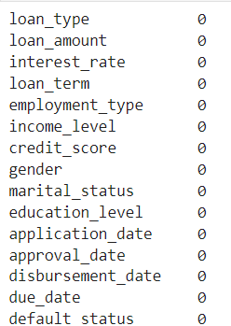
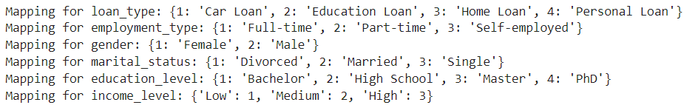
Data Preparation and Exploration
Handling Missing Values
Encoding Categorical Variables
Scaling Numerical Features:
Exploratory Data Analysis
Imputed missing values using the mean for numerical features and the mode for categorical features.
Used Label Encoding for categorical features, ensuring that no encoded value is 0 and maintaining a mapping for clarity.
Applied Standard Scaler to standardize numerical features so that it has a mean of 0 and a standard deviation of 1.
Checked for data imbalance in the target variable. Created visualizations like scatter plots and pie charts to analyze the distribution and relationships in the data.
Check for Imbalance in target variable
Check for feature distributions
Check Linear Relationship between target variable and features
4

Slide 5
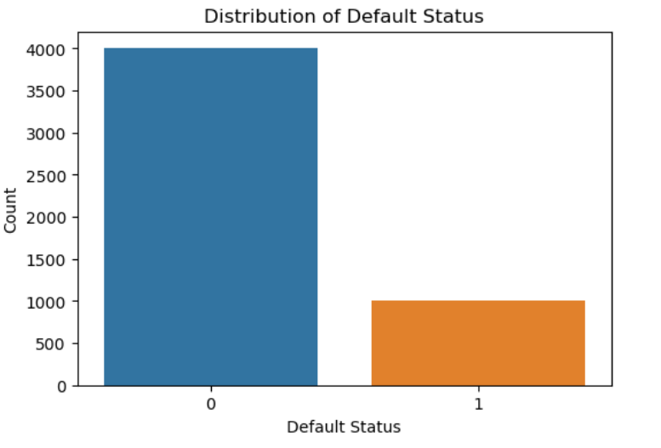
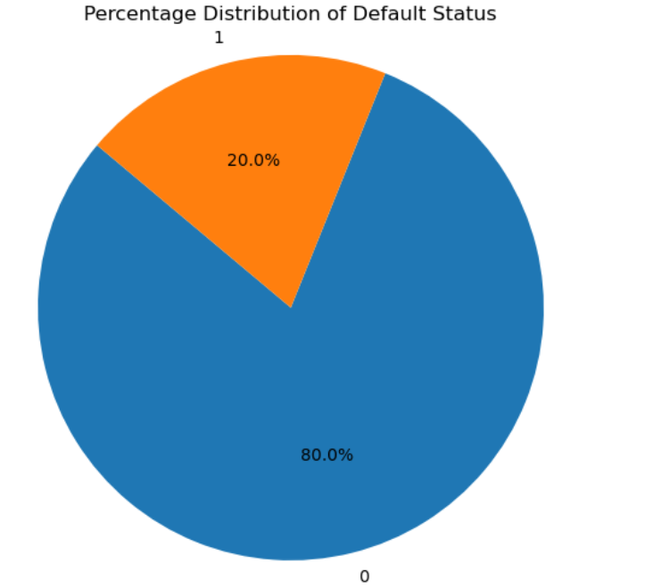
Process Flow of the Explanatory Analysis
Imbalance in Target Variable
The variable/attribute "Default Status" represents whether or not the customer has paid or defaulted on loan. This variable is the target or dependent variable that will be predicted in the model. The following graphs provides a visual representation of the distribution of data for this variable.
Based on the chart, it is evident that out of the total 5,000 records, 4,001 (80%) are classified as 0 and 999 (20%) are classified as 1. This indicates that the majority of customers has paid the loan and did not default. This distribution is known as imbalanced, which could cause modeling issues and low performance levels for the imbalanced value. In the upcoming phases, this issue will be tackled.
5

Slide 6
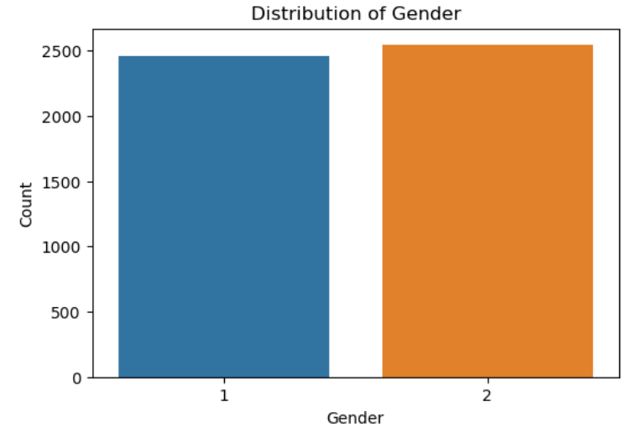
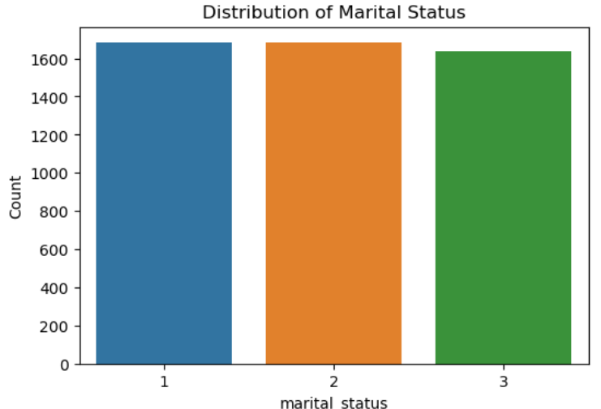
Process Flow of the Explanatory Analysis
Feature Distribution
The variables gender and marital status are control variables, that make sure our dataset is representative of the demography of the customers for the bank.
Here we see that, the distribution of the gender and martial status is evenly distributed across the dataset. Eliminating any skewness in the data towards a particular gender, or martial status. Normalising the dataset has reduced the likelihood of confounded bias.
6

Slide 7
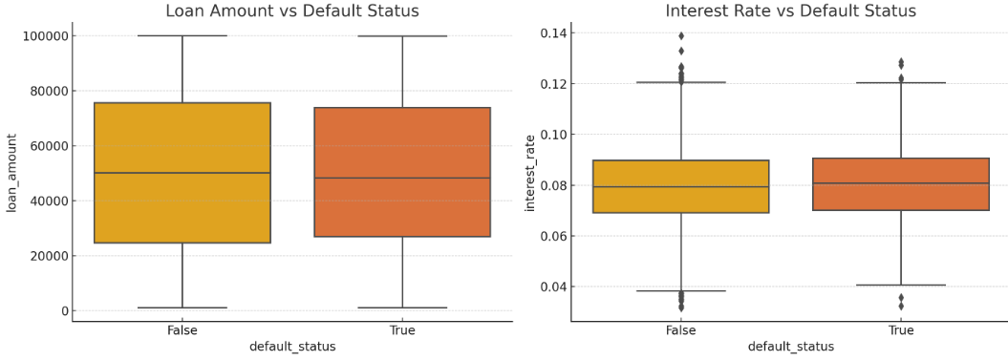
Process Flow of the Explanatory Analysis
Relationship between Features and the Target Variable
The boxplots reveal the following insights regarding the relationship between numerical features and the default status:
Loan Amount vs Default Status: There is a slight difference in loan amounts between defaulters and non-defaulters, with defaulters tending to have higher loan amounts.
Interest Rate vs Default Status: Defaulters tend to have higher interest rates compared to non-defaulters.
7

Slide 8
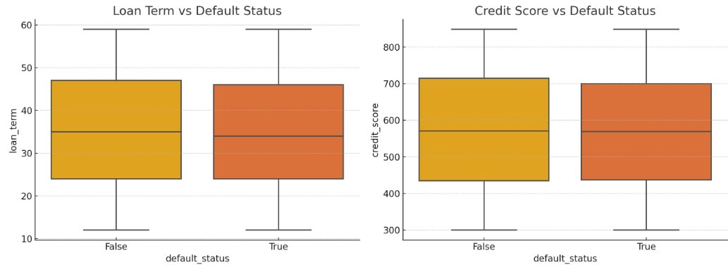
Process Flow of the Explanatory Analysis
Relationship between Features and the Target Variable
The boxplots reveal the following insights regarding the relationship between numerical features and the default status:
Loan Term vs Default Status: There is no significant difference in loan term between defaulters and non-defaulters.
Credit Score vs Default Status: Defaulters tend to have lower credit scores compared to non-defaulters.
8

Slide 9
Predicting Loan Defaulters for Bajaj Finserv Ltd
Data Preparation and Exploration
01.
The objective is to transform raw data into a suitable format for modeling and to understand the underlying patterns. From handling missing values to some basic exploratory data analysis to understand the data.
Machine Learning Model Development and Evaluation
02.
The objective is to develop initial predictive models and evaluate their performance without addressing class imbalance and compare with the outcomes when we improve model performance by addressing class imbalance using SMOTE (Synthetic Minority Over-sampling Technique).
Feature Importance and Recommendations
03.
A concise overview of the best-performing model and the resulting actionable recommendations based on the focus areas and suggestions on how to further enhance predictive power of model.

Slide 10

Model Training and Evaluation
To build a model that predicts loan defaults, it needs to be trained using algorithms. In this study, various algorithms are used and analyzed to determine which one is the best performing one. The algorithms used in this research are:
1
Logistic Regression
This algorithm is a statistical method that predicts the probability of each class, and the algorithm displays the probability of that prediction (e.g., an 80% chance that the class is 1).
“The Logistic Regression models were recognized as the most appropriate models in deciding to grant credit to individuals and regarded as the industry standard in credit scoring model development” (Victor & Raheem, 2021).
3
Adaptive Boost
AdaBoost is one of the first boosting algorithms to have been introduced.
It makes use of weighted errors to build a strong classifier from a series of weak classifiers.
Gradient Boosting
Gradient boosting works by building simpler (weak) prediction models sequentially where each model tries to predict the error left over by the previous model.
2
Decision Tree
Decision Tree works by separating into different nodes, where each node represents a variable. The variable that affects the prediction the most is placed at the beginning and then continuing with the other variables below which are of less important (hierarchy).
The Random Forest algorithm is one of the most flexible, powerful and widely-used algorithms built as an ensemble of Decision Trees.
4
Support Vector Machine (SVM)
“It works on the principle of fitting a boundary to a region of points that are all alike (that is, belong to one class)” (Kotu & Deshpande, 2019).
So, the model is trained on some historical data and based on similarities it is divided into regions, thus when the new records comes it goes to the region where the features are similar.
3
Ensemble Algorithms
“Ensemble techniques are the methods that use multiple learning algorithms or models to produce one optimal predictive model. The model produced has better performance than the base learners taken alone” (Khandelwal, 2021). For this project, we only focus on boosting.
5
Neural Network
This algorithm is more advanced than the classical algorithms.
“A neural network consists of a set of neurons that are connected together. A neuron takes a set of numeric values as input and maps them to a single output value. At its core, a neuron is simply a multi-input linear-regression function.” (Kelleher & Tierney, 2018).
To determine the effectiveness and performance of the predictive model, it must be evaluated using the following metrics;
ACCURACY, PRECISION, RECALL and F1-SCORE
10

Slide 11
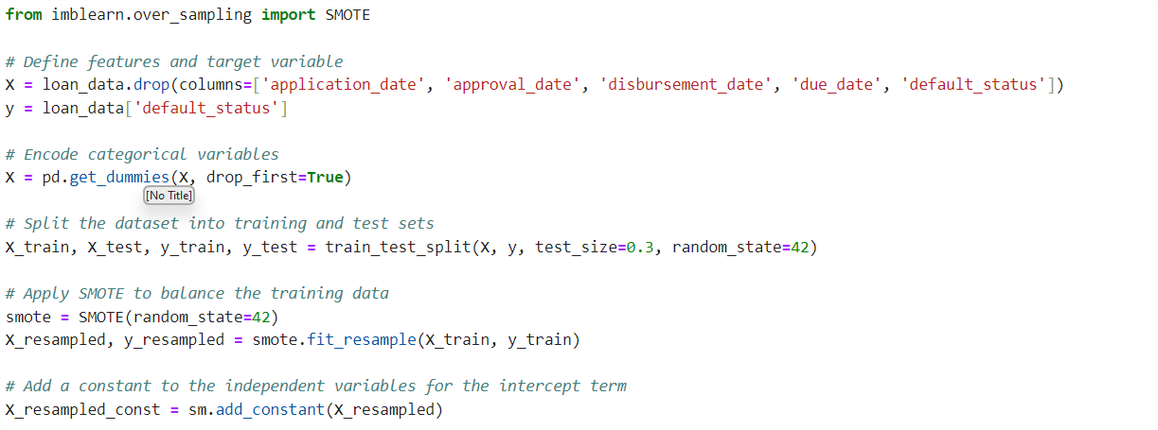
Synthetic Minority Over-sampling Technique
To address class imbalance in the training data, we used SMOTE (Synthetic Minority Over-sampling Technique).
The output Counter {0: 3201, 1: 3201} indicates the number of instances for each class in the default_status variable after applying the Synthetic Minority Over-sampling Technique (SMOTE).
Class Balance
0: 3201 means there are now 3201 instances of the Non-Defaulter class (default status 0). *1: 3201 means there are now 3201 instances of the Defaulter class (default status 1).
Before applying SMOTE, the dataset was imbalanced, with one class having significantly fewer instances than the other. SMOTE generates synthetic samples for the minority class to balance the dataset. After applying SMOTE, both classes have the same number of instances, achieving a balanced dataset.
SMOTE first selects a minority class instance, a, at random and finds its k nearest minority class neighbors. The synthetic instance is then created by choosing one of the k nearest neighbors, b, at random and connecting a and b to form a line segment in the feature space. The synthetic instances are generated as a convex combination of the two chosen instances a and b.
11

Slide 12
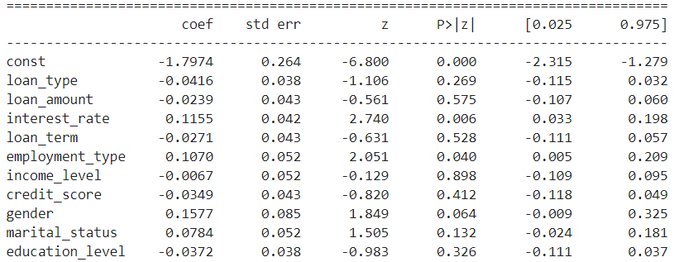
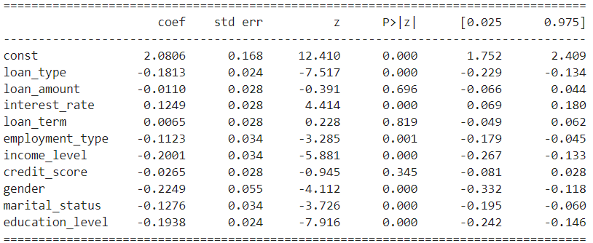
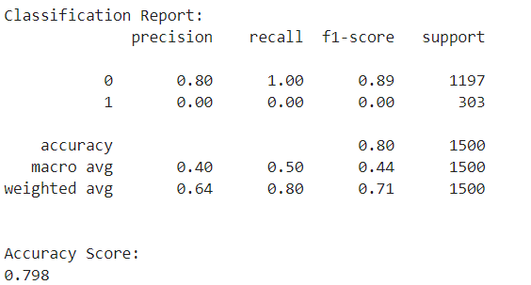
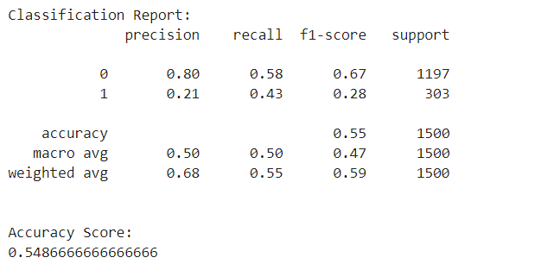
Logistic Regression
Results without SMOTE
Results with SMOTE
Interpretation
The Pseudo R-squared value is very low (0.005989), suggesting that the model explains only a small portion of the variability in the data.
Significant Features:
Interest Rate and Employment Type are the only statistically significant predictors of default status. Gender is statistically at a higher p-value > 0.1. Income Level, Loan Amount, Loan Type, Loan Term, Credit Score, Gender, Marital Status, and Education Level are not statistically significant predictors (p-values > 0.05).
Interpretation
The Pseudo R-squared value is still very low (0.02698), suggesting that the model explains only about 2.7% of the variability in the default status.
Significant Features:
Features like loan_type, interest_rate, employment_type, income_level, gender, marital_status, and education_level are highly significant predictors of default status. While SMOTE helps address the class imbalance, the model still has difficulty predicting defaulters accurately, as seen in the high number of false positives and false negatives.
12

Slide 13
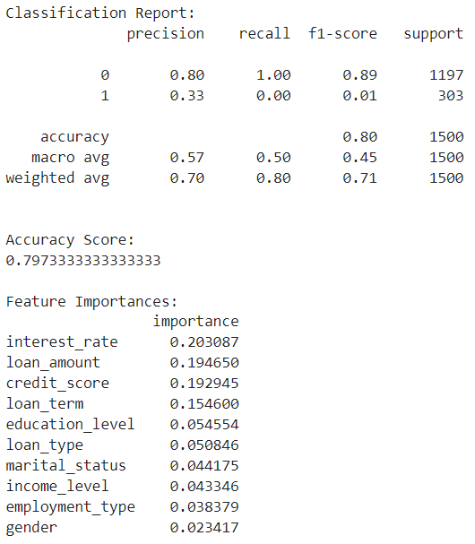
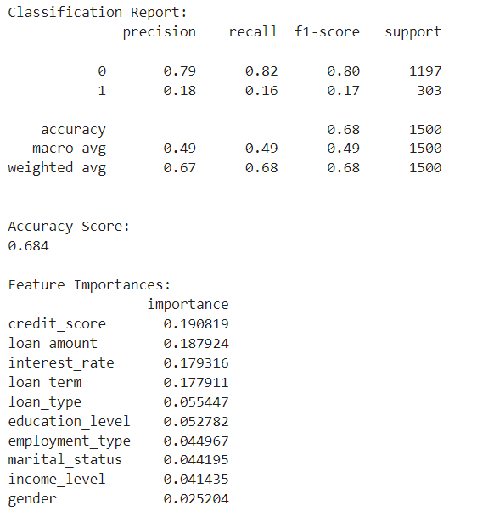

Random Forest Classifier
Without SMOTE
With SMOTE
Random Forest Classifier is the best-performing model with SMOTE as identified based on the highest accuracy of 68.4%, 79% precision, and 80% F1 scores.
Source: Statista, 2023
Model Performance
Without SMOTE, the accuracy is higher (79.7%) compared to with SMOTE (68.4%). This is because the model is biased towards the majority class (non-defaulters) in the imbalanced dataset. The recall for class 1 (defaulters) is 0.00 without SMOTE, meaning the model fails to identify any defaulters. With SMOTE, the recall for class 1 improves to 0.16, indicating the model is better at identifying defaulters when the dataset is balanced. Without SMOTE, the model heavily favors the majority class (non-defaulters), as seen in the very high recall for class 0 and almost zero for class 1. With SMOTE, the model shows a more balanced performance, with improved recall for class 1, but at the cost of a decrease in overall accuracy.
The important features remain consistent in both cases, with interest_rate, loan_amount, credit_score and loan_term being the top four. However, their relative importances shift slightly with SMOTE applied.
13

Slide 14
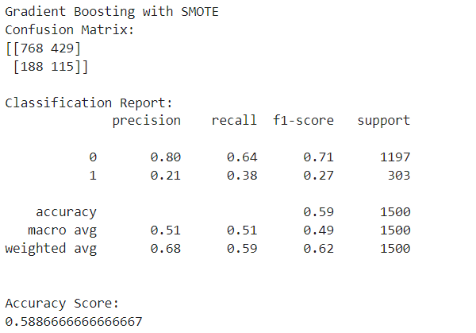
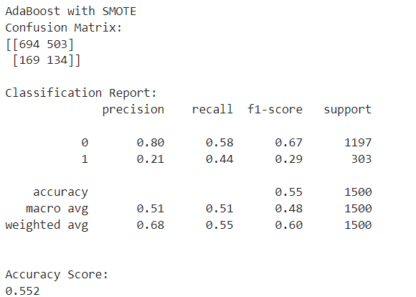
Gradient Boosting and AdaBoost with SMOTE
Gradient Boosting
AdaBoost
14

Slide 15
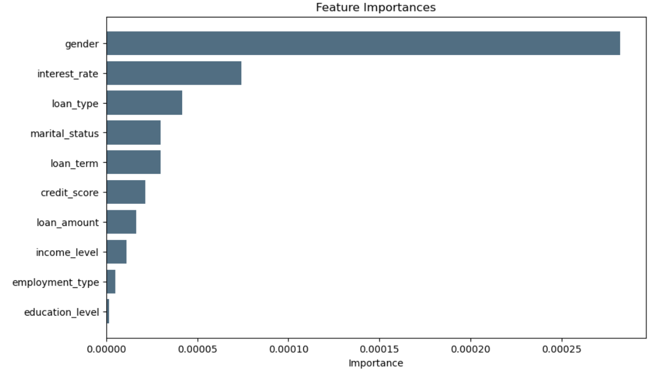
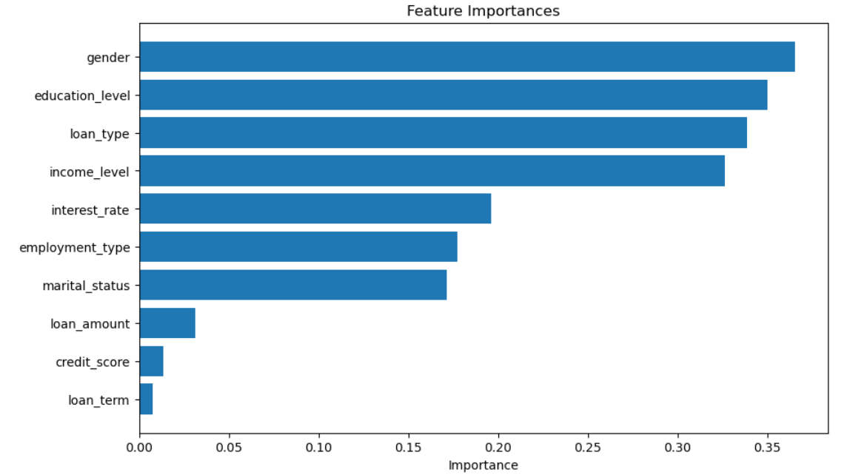
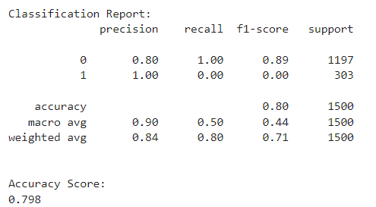
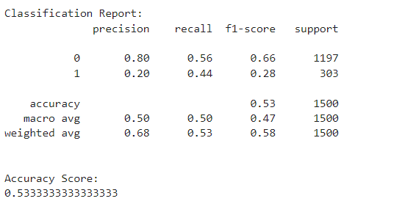
Support Vector Machine
Results without SMOTE
Results with SMOTE
The model without SMOTE has a higher accuracy score, indicating it performs better overall. However, accuracy alone can be misleading, especially if the data is imbalanced. The top three important features are interest_rate, loan_type and loan_term.
The model with SMOTE has a better chance predicting the non-defaulters more accurately than without SMOTE despite a lower accuracy score. The top three important features are now education_level, loan_type and income_level.
15

Slide 16
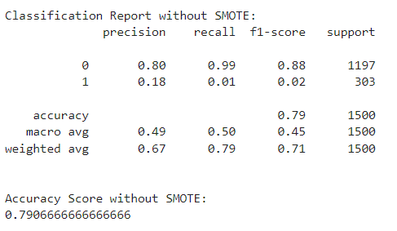
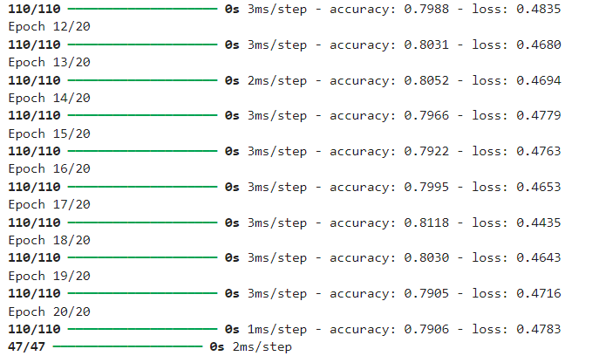
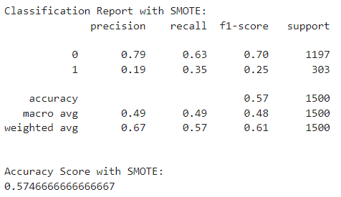
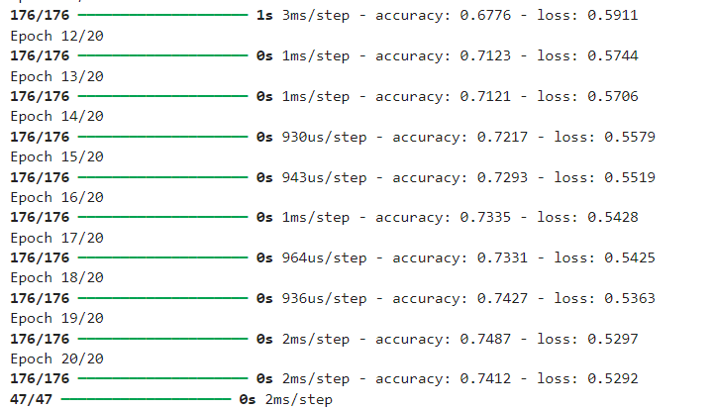
Neural Network
Without SMOTE
With SMOTE
16

Slide 17
Predicting Loan Defaulters for Bajaj Finserv Ltd
Data Preparation and Exploration
01.
The objective is to transform raw data into a suitable format for modeling and to understand the underlying patterns. From handling missing values to some basic exploratory data analysis to understand the data.
Machine Learning Model Development and Evaluation
02.
The objective is to develop initial predictive models and evaluate their performance without addressing class imbalance and compare with the outcomes when we improve model performance by addressing class imbalance using SMOTE (Synthetic Minority Over-sampling Technique).
Feature Importance and Recommendations
03.
A concise overview of the best-performing model and the resulting actionable recommendations based on the focus areas and suggestions on how to further enhance predictive power of model.

Slide 18
Literature on Predicting Loan Defaulters
Random Forest Classifier is our best-performing model with SMOTE while the Logistic Regression model dominates over the others without SMOTE.
Zhu, et al., (2019): Different ML models were applied, such as Decision Tree, SVM, Logistic Regression, and Random Forest , the SMOTE method was used together with the Random Forest to address the issue of data imbalance, achieving the highest accuracy of 98%
Tariq, et al., (2019): Using the SEMMA (Sample, Explore, Modify, Model and Assess) methodology, the best performance was chosen Logistic Regression, since it was the best in predicting "True Negatives" (how accurate is the model for predicting loans that default)
Without SMOTE
Owusu, et al., (2023): This study addresses loan default in online peer-to-peer lending activities. Due to the imbalanced nature of the dataset, the adaptive synthetic (ADASYN) oversampling algorithm is used to balance the data. Deep neural network (DNN) is used for prediction with accuracy of 94.1% is realized
Platur Gashi, (2023): This paper presents several models for predicting loan defaults using a variety of ML algorithms with SMOTE. The results demonstrate that ensemble algorithms outperform individual ones in predicting loan defaults. The top-performing algorithms were Boosted Decision Trees (Boosting) and Random Forest (Bagging).
Victor & Raheem, (2021):
The "Genetic Algorithm" used here is based on Darwin's theory of evolution, which after many calculations selects the variables that have the most impact on the target variable. Logistic Regression, Random Forest, and SVM
algorithms were used for predictive modeling, the most successful algorithm was Random Forest, achieving 82% F1 score
Abedin, et al., (2023): In small business credit risk assessment, the default and nondefault classes are highly imbalanced. Using Weighted-SMOTE ensemble to overcome the imbalance, this study proposes that the Random Forest Classifier provides a good trade-off between the performance on default class and that of nondefault class
With SMOTE
18

Slide 19



Important Features in predicting Default Status
We determine the important features in predicting default status after building and evaluating the best performing model with SMOTE (Random Forest) and the one without SMOTE (Logistic Regression). While, controlling for other factors, an increase in the interest rate or the loan amount, or a decrease in the credit score or; self-employed and part-time employees are associated with an increased probability of default.
The insights derived from this analysis highlight the importance of incorporating various financial and demographic factors into predictive models, as well as the benefits of using advanced machine learning techniques and data balancing methods like SMOTE. By integrating these recommendations, lenders can enhance their ability to accurately assess borrower risk, leading to better lending decisions and reduced default rates.
Credit Score
Interest Rate
Credit score is a crucial predictor for defaulting on a loan due to its strong relationship with a borrower's creditworthiness and financial behavior. Credit scores are based on a borrower's credit history, which includes data on past loans, repayment behavior, defaults, bankruptcies, and other credit-related activities. Lenders use credit scores as a primary measure of creditworthiness. A lower score can indicate higher risk of defaulting on their loan.
Lenders often assign higher interest rates to borrowers they deem to be higher risk, or have a higher likelihood of default based on their credit history, income stability, etc. High interest rates can also be reflection of economic downturns, inflation, or tighter monetary policy which can increase the cost of borrowing and living expenses, making it harder for borrowers to meet their loan obligations. Borrowers with higher monthly obligations may struggle more to keep up with payments
Loan Amount
Employment Type
Larger loan amounts often carry higher risk. Borrowers who take out larger loans may have higher monthly payments, which can strain their finances. If the loan amount is disproportionately large compared to the borrower's income, it increases the likelihood of default. Borrowers with higher loan amounts relative to their income may struggle to meet repayment obligations.
Employment type can be a significant predictor for defaulting on a loan due to several factors related to job stability, income consistency, and overall financial security. Individuals in less stable jobs may have fewer financial cushions or resources and lack job security, making it difficult for individuals to guarantee steady income over time, leading to higher default rates.
19

Slide 20

THANK YOU.
Tendai Jonhasi
tendaimjonhasi@gmail.com
LinkedIn profile
GitHub

